Slide 1
OS Security
Goodrich and Tamassia Chapter 3
Prepared by Nafis Irtiza Tripto
Lecturer, CSE BUET

Slide 2
Security Features of an Ordinary OS
User identification and authentication
File and I/O device access control
Table lookup of ACL matrix
Memory protection
Usually preformed by hardware mechanisms, e.g., paging or segmentation
Enforcement of sharing
Need to guarantee integrity and consistency
Table lookup combined with integrity control
Guarantee of fair service
No starvation
Scheduling disciplines + hardware clocks
Interprocess communication and synchronization
Mediated by access control tables.

Slide 3
Process security

Slide 4
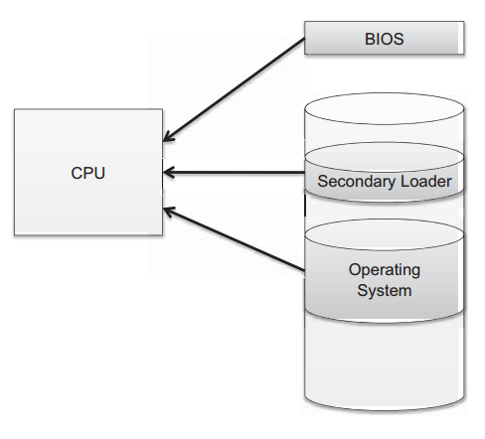
The boot sequence
The action of loading an operating system into memory from a powered-off state is known as booting, originally bootstrapping.
When a computer is turned on, it first executes code stored in a firmware component known as the BIOS (basic input/output system).
On modern systems, the BIOS loads into memory the second-stage boot loader, which handles loading the rest of the operating system into memory and then passes control of execution to the operating system.

Slide 5
BIOS Attack
First stage
Second stage
To prevent an attacker from initiating the first stages of booting, many computers feature a BIOS password that does not allow a second-stage boot loader to be executed without proper authentication.
Most second-stage boot loaders allow the user to specify which device should be used to load the rest of the operating system.
In most cases, this option defaults to booting from the hard drive, or in the event of a new installation, from external media such as a DVD drive.
many computers utilize second stage boot loader that feature password protections from external storage media

Slide 6
Hibernation
Modern machines have the ability to go into a powered-off state known as hibernation
While going into hibernation, the operating system stores the entire contents of the machine’s memory into a hibernation file on disk so that the state of the computer can be quickly restored when the system is powered back on.
Since the entire contents of memory are stored into the hibernation file, any passwords or sensitive information that were stored in memory at the time of hibernation are preserved.
Windows storesas C:\hiberfil.sys. A live CD attack can be performed to gain access to the hibernation file

Slide 7
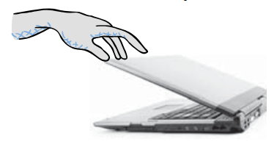
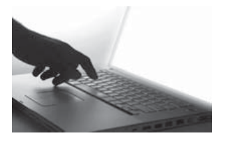
Attacks at the time of Hibernation
A live CD attack can be performed to gain access to the hibernation file.
Attacks that modify the hiberfil.sys file have also been demonstrated, so that the execution of programs on the machine is altered when the machine is powered on.
1. User closes a laptop computer, putting it into hibernation.
2. Attacker copies the hiberfil.sys file to discover any unencrypted passwords that were stored in memory when the computer was put into hibernation.
Notes:
Interestingly, Windows does not delete the hibernation file after resuming execution, so it may persist even after the computer is rebooted several times.

Slide 8
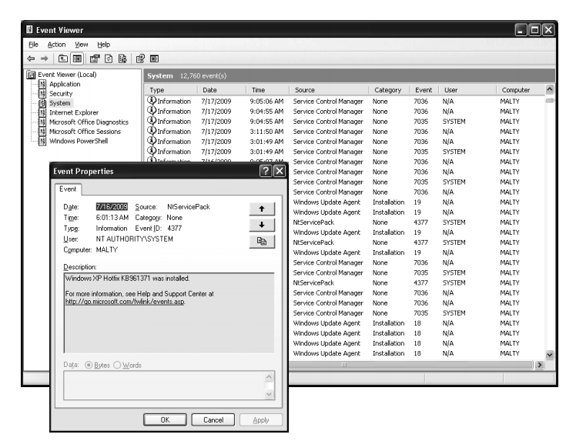
Event Logging (Windows)
Windows includes an event logging system known simply as the Windows Event Log.
Windows defines three possible sources of logs, “System,” “Application,” and “Security.”
The System log can only be written to by the operating system itself
Application log may be written to by ordinary applications.
Security log can only be written to by a special Windows service known as the Local Security Authority Subsystem Service, visible in Process Explorer as lsass.exe.
In addition to these three predefined sources, users can define their own log sources.

Slide 9
Event logging(Linux)
log files are stored in /var/log or some similar location and are simple text files with descriptive names.
auth.log contains records of user authentication,
kern.log keeps track of unexpected kernel behavior.
writing to these log files can only be done by a special syslog daemon.

Slide 10
Process Monitoring
Why?
How?
our computer might be sluggish and we want to identify an application using up lots of CPU cycles or memory.
our computer has been compromised by a virus and we want to check for suspicious processes.
Windows include the task manager application
Linux has ps, top, pstree, and kill commands

Slide 11
Memory and file system security

Slide 12
Motivation
The contents of a computer are encapsulated in its memory and filesystem.
protection of a computer’s content has to start with the protection of its memory and its filesystem.

Slide 13
Virtual Memory Security
On Windows, virtual memory pages that have been written to the hard disk are actually contained in what is known as the page file, located at C:\pagefile.sys
Linux, on the other hand, typically requires users to set up an entire partition of their hard disk, known as the swap partition, to contain these memory pages.
Each operating system enforce rules preventing users from viewing the contents of virtual memory files while the OS is running,
It may be configured such that they are deleted when the machine is shut down.

Slide 14
Attack on virtual memory
However, if an attacker suddenly powered off the machine without properly shutting down and booted to another operating system via external media, it may be possible to view these files and reconstruct portions of memory, potentially exposing sensitive information
To mitigate these risks, hard disk encryption should be used in all cases where potentially untrusted parties have physical access to a machine.

Slide 15
Password Authetication
User
Password file
kiwifruit
exrygbzyf
kgnosfix
ggjoklbsz
…
…
hash function

Slide 16
Basic password authentication
Setup
User chooses password
Hash of password stored in password file
Authentication
User logs into system, supplies password
System computes hash, compares to file
Attacks
Online dictionary attack
Guess passwords and try to log in
Offline dictionary attack
Steal password file, try to find p with hash(p) in file

Slide 17
Dictionary Attack – some numbers
Typical password dictionary
1,000,000 entries of common passwords
people's names, common pet names, and ordinary words.
Suppose you generate and analyze 10 guesses per second
This may be reasonable for a web site; offline is much faster
Dictionary attack in at most 100,000 seconds = 28 hours, or 14 hours on average
If passwords were random
Assume six-character password
Upper- and lowercase letters, digits, 32 punctuation characters
689,869,781,056 password combinations.
Exhaustive search requires 1,093 years on average

Slide 18
Password Salt
One way to make the dictionary attack more difficult to launch is to use salt
associating a random number with each userid
Rather than comparing the hash of an entered password with a stored hash of a password, the system compares the hash of an entered password and the salt for the associated userid with a stored hash of the password and salt

Slide 19
Password Salt
Unix password line
walt:fURfuu4.4hY0U:129:129:Belgers:/home/walt:/bin/csh
Compare
Salt
Input
Key
Constant
Ciphertext
25x DES
Plaintext
When password is set, salt is chosen randomly

Slide 20
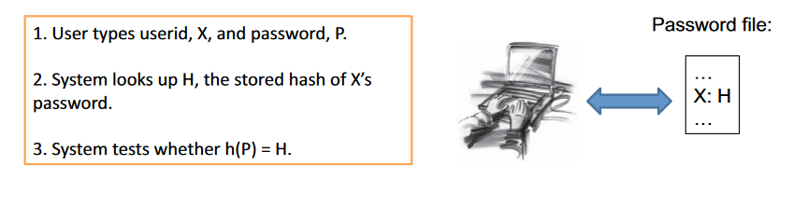
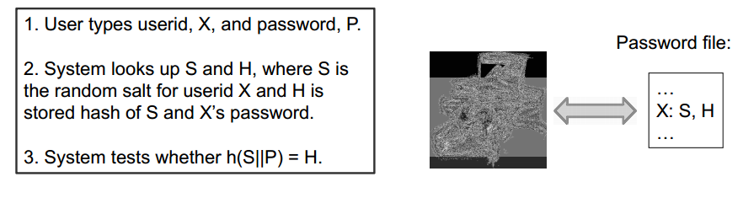
How Password Salt works
Without Salt
With Salt

Slide 21
How Salt Increases Search Space Size
Assuming that an attacker cannot find the salt associated with a userid he is trying to compromise, then the search space for a dictionary attack on a salted password is of size 2^B × D where B is the number of bits of the random salt and D is the size of the list of words for the dictionary attack.
For example, if a system uses a 32-bit salt for each userid and its users pick the kinds of passwords that would be in a 500,000 word dictionary, then the search space for attacking salted passwords would be
232 × 500,000 = 2,147,483,648,000,000
Also, even if an attacker can find the salt associated with each userid (which the system should store in encrypted form), by employing salted passwords, an operating system can limit his dictionary attack to one userid at a time

Slide 22
Access control

Slide 23
Access control
Common Assumption
System knows who the user is
User has entered a name and password, or other info
Access requests pass through gatekeeper
OS must be designed monitor cannot be bypassed
Reference
monitor
?
Resource
User process
Decide whether user can apply operation to resource

Slide 24
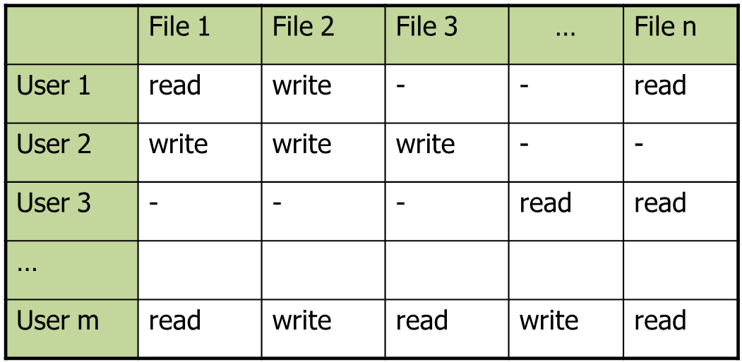
Access control matrix
Objects
Subjects

Slide 25
Two implementation concepts
 | File 1 | File 2 | …
User 1 | read | write | -
User 2 | write | write | -
User 3 | - | - | read
…
User m | read | write | write
Access control list (ACL)
Store column of matrix
with the resource
Capability
User holds a unforgeable “ticket” for each resource
Access control lists are widely used, often with groups (E.g., UNIX file system)
Some aspects of capability concept are used in Kerberos

Slide 26
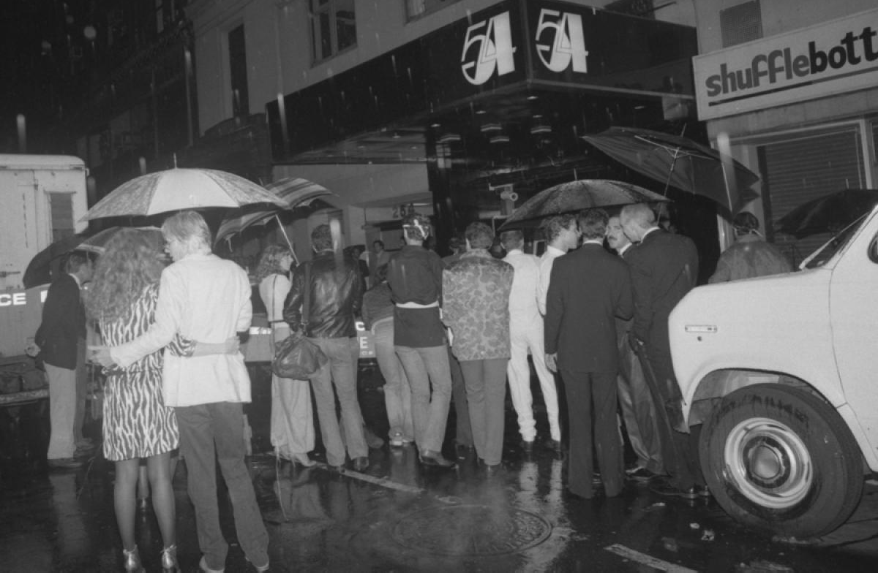
ACL: my name is on the list

Slide 27
Capability: I have a ticket

Slide 28
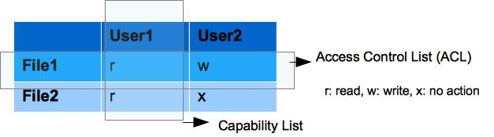
ACL vs Capabilities
Access control list
Associate list with each object
Check user/group against list
Relies on authentication: need to know user
Capabilities
Capability is unforgeable ticket associated with object
Can be passed from one process to another
Reference monitor checks ticket
Does not need to know identify of user/process

Slide 29
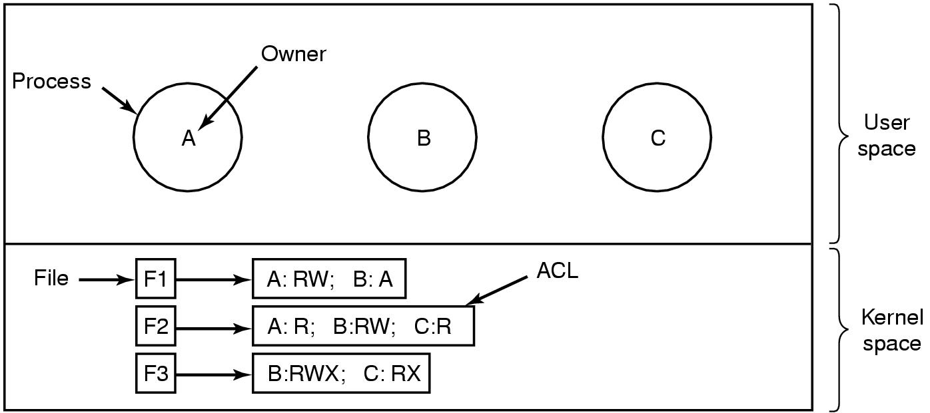
ACL vs Capabilities

Slide 30
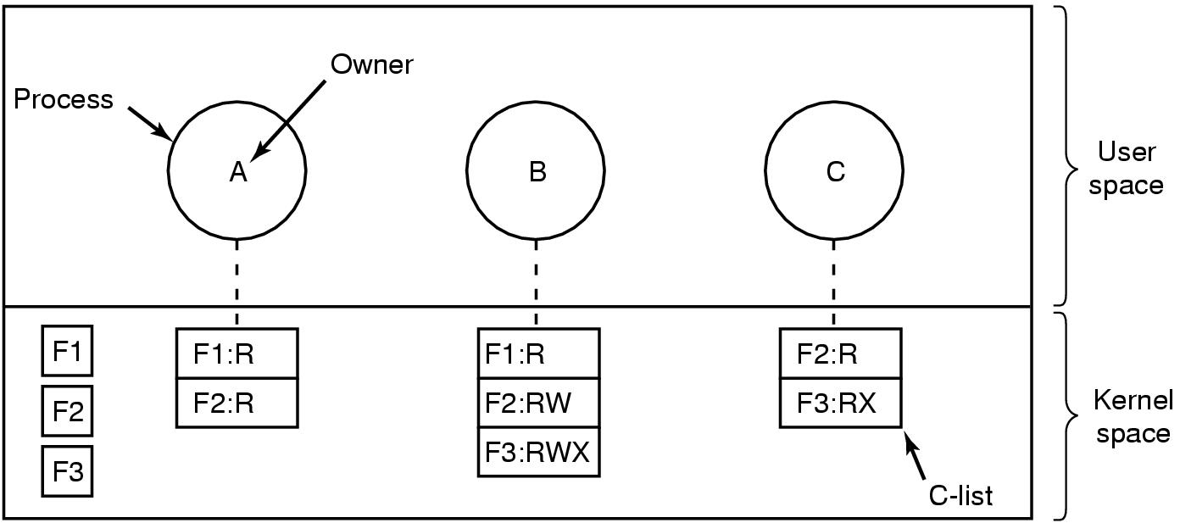
ACL vs Capabilities

Slide 31
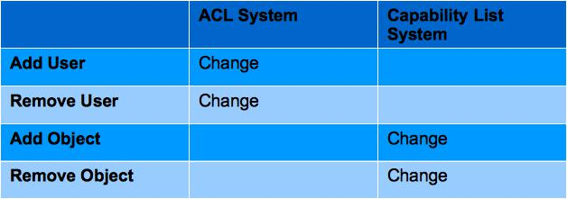
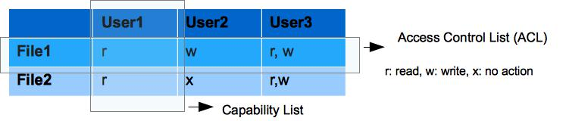
Delegation and Revocation
if a system has fewer user centric operations and more object centric operation ACL is good for it,
Is Capability model a good fit in the system where more user centric action is required?
Notes:
So, the point to make here is that in ACL based System, on adding / removing a user, there may be a changed required in the ACL of existing object. On the other hand, similarity, in the capability system, there may be a change required in the Capability list of existing user on addition or removal of an object.
if a system has fewer user centric operations (ex. add user, remove user, change in user’s privilege label) and more object centric operation (ex. add object, remove object) ACL is good for it, because in this case ACL required less change than its corresponding Capability list.

Slide 32
Discretionary Access Control (DAC)
Users can protect what they own
–The owner may grant access to others
–The owner may define the type of access (read/write/execute) given to others
DAC is the standard model used in operating systems
Mandatory Access Control (MAC)
–Alternative model not covered in this lecture
–Multiple levels of security for users and documents
–Read down and write up principle

Slide 33
Closed vs. Open Policy
Closed policy
Open policy
Give Tom read access to “foo”
Give Bob r/w access to “bar
Tom: I would like to read “foo”
Access allowed
Tom: I would like to read “bar”
Access denied
Deny Tom read access to “foo”
Deny Bob r/w access to “bar”
Tom: I would like to read “foo”
Access denied
Tom: I would like to read “bar”
Access allowed

Slide 34
Closed Policy with Negative Authorizations and Deny Priority
Give Tom r/w access to “bar”
Deny Tom write access to “bar ”
Tom: I would like to read “bar”
Access allowed
Tom: I would like to write “bar ”
Access denied
Policy is used by Windows to manage access control to the file system

Slide 35
Unix Roles (aka Groups)
Role = set of users
Administrator, PowerUser, User, Guest
Assign permissions to roles; each user gets permission
Role hierarchy
Partial order of roles
Each role gets
permissions of roles below
List only new permissions
given to each role
Administrator
PowerUser
User
Guest

Slide 36
Unix Access Control
What access control concepts are used?
Truncated access control list
A form of role-based access control
 | File 1 | File 2 | …
User 1 | read | write | -
User 2 | write | write | -
User 3 | - | - | read
…
Role r | Read | write | write
 | File 1 | File 2 | …
Owner | read | write | -
Group | write | write | -
Other | - | - | read

Slide 37
Unix file access control list
Each file has owner and group
Permissions set by owner
Read, write, execute
Owner, group, other
Represented by vector of
four octal values
Only owner, root can change permissions
This privilege cannot be delegated or shared
Setid bits – Discuss in a few slides
rwx
rwx
rwx
ownr
grp
othr

Slide 38
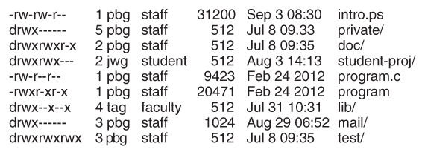
Example directory listing
access owner group size modification name

Slide 39
Process effective user id (EUID)
Each process has three Ids (+ more under Linux)
Real user ID (RUID)
same as the user ID of parent (unless changed)
used to determine which user started the process
Effective user ID (EUID)
from set user ID bit on the file being executed, or sys call
determines the permissions for process
file access and port binding
Saved user ID (SUID)
So previous EUID can be restored
Real group ID, effective group ID, used similarly

Slide 40
Process Operations and IDs
Root
ID=0 for superuser root; can access any file
Fork and Exec
Inherit three IDs, except exec of file with setuid bit
Setuid system call
seteuid(newid) can set EUID to
Real ID or saved ID, regardless of current EUID
Any ID, if EUID is root

Slide 41
Password Dilemma
In linux users information is stored in /etc/passwd file
Write access to root
Read access to all other
Passwords are stored using hash in /etc/shadow file
Readable to root only
How can a user then modify his password?
Privilege Escalation

Slide 42
Special Permission Bits
Three setid bits
Setuid – set EUID of process to ID of file owner
Setgid – set EGID of process to GID of file
Sticky
Off: if user has write permission on directory, can rename or remove files, even if not owner
On: only file owner, directory owner, and root can rename or remove file in the directory

Slide 43
Process Operations and IDs
Details are actually more complicated
Several different calls: setuid, seteuid, setreuid
ID | Set-user-ID bit off | Set-user-ID bit on
RUID | Unchanged | Unchanged
EUID | Unchanged | Set from user ID of program file
SUID | Copied from EUID | Copied from EUID

Slide 44
Set-user-ID (“suid” or “setuid”) bit
On executable files, causes the program to run as file owner regardless of who runs it
Ignored for everything else
In 10-character display, replaces the 4th character (x or -) with s(or S if not also executable)
-rwsr-xr-x: setuid, executable by all
-rwxr-xr-x: executable by all, but not setuid
-rwSr--r--: setuid, but not executable - not useful

Slide 45
Set-group-ID (“sgid” or “setgid”) bit
On executable files, causes the program to run with the file’s group, regardless of whether the user who runs it is in that group
On directories, causes files created within the directory to have the same group as the directory, useful for directories shared by multiple users with different default groups–Ignored for everything else
In 10-character display, replaces 7th character (x o r -) with s(or S if not also executable)
-rwxr-sr-x: setgid file, executable by all
drwxrwsr-x: setgid directory; files within will have group of directory
-rw-r-Sr-- : setgid file, but not executable - not useful

Slide 46
Sticky Bit
On directories, prevents users from deleting or renaming files they do not own
Ignored for everything else
In 10-character display, replaces 10th character (x or -) with t(or T if not also executable)
drwxrwxrwt: sticky bit set, full access for everyone
drwxrwx--T: sticky bit set, full access by user/group
drwxr--r-T: sticky, full owner access, others can read (useless)

Slide 47
Setuid(uid) system calls
ID | Super user | Unprivileged user
RUID | Set to uid | Unchanged
EUID | Set to uid | Set to uid
SUID | Set to uid | unchanged

Slide 48
Example
Owner 18
RUID 25
SetUID
…;
…;
exec( );
program
Owner 18
…;
…;
i=getruid()
setuid(i);
…;
…;
-rw-r--r--
file
read/write
RUID 25
EUID 18
Owner 25
-rw-r--r--
read/write
RUID 25
file
EUID 25

Slide 49
Root User
“root” account is a super-user account, like Administrator on Windows
Multiple roots possible
File permissions do not restrict root
This is dangerous, but necessary, and OK with good practices

Slide 50
Changing Permissions
Permissions are changed with chmod or through a GUI like Konqueror
Only the file owner or root can change permissions
If a user owns a file, the user can use chgrp to set its group to any group of which the user is a member
root can change file ownership with chown (and can optionally change group in the same command)
chown, chmod, and chgrp can take the -R option to recur through subdirectories

Slide 51
Examples of Changing Permissions
chown -R root dir1 | Changes ownership of dir1 and everything within it to root
chmod g+w,o-rwx file1 file2 | Adds group write permission to file1 and file2, denying all access to others
chmod -R g=rwX dir1 | Adds group read/write permission to dir1 and everything within it, and group execute permission on files or directories where someone has execute permission
chgrp testgrp file1 | Sets file1’s group to testgrp, if the user is a member of that group
chmod u+s file1 | Sets the setuid bit on file1. (Doesn’t change execute bit.)

Slide 52
Octal Notation
Previous slide’s syntax is nice for simple cases, but bad for complex changes
– Alternative is octal notation, i.e., three or four digits from 0 to 7
Digits from left (most significant) to right(least significant):
[special bits][user bits][group bits][other bits]
Special bit digit =
(4 if setuid) + (2 if setgid) + (1 if sticky)
All other digits =
(4 if readable) + (2 if writable) + (1 if executable)

Slide 53
Octal Notation Examples
644 or 0644 | read/write for owner, read-only for everyone else
775 or 0775 | read/write/execute for owner and group, read/execute for others
640 or 0640 | read/write for owner, read-only for group, forbidden to others
2775 | same as 775, plus setgid (useful for directories)
777 or 0777 | read/write/execute to everyone (dangerous!)
1777 | same as 777, plus sticky bit

Slide 54
Unix access control summary
Good things
Some protection from most users
Flexible enough to make practical systems possible
Main limitation
Coarse-grained ACLs – user, group, other
Too tempting to use root privileges
No way to assume some root privileges without all

Slide 55
Access control in Windows
Full access control lists
Specify access for groups and users
Read, modify, change owner, delete
Some additional concepts
Tokens
Security attributes
Generally, more precise, more flexible than Unix
Can define new permissions
Can transfer some but not all privileges (cf. capabilities)

Slide 56
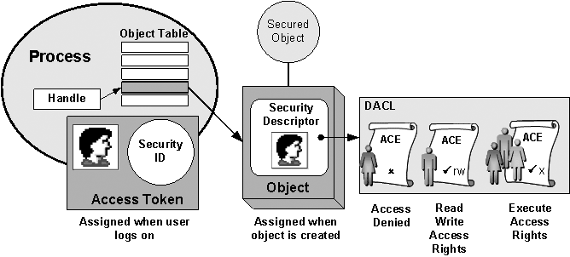

Slide 57
Process has set of tokens
Called the process “security context”
Privileges, accounts, and groups associated with the process or thread
Presented as set of tokens
Interesting feature: impersonation token
Used temporarily to adopt a different security context, usually of another user (similar to use of capability/setuid)

Slide 58
Object has security descriptor
Specifies who can perform what actions on the object
Header (revision number, control flags, …)
SID of the object's owner
SID of the primary group of the object
Two attached optional lists:
Discretionary Access Control List (DACL) – users, groups, …
System Access Control List (SACL) – system logs, ..

Slide 59
Example access request
Access token
User: Mark
Group1: Administrators
Access request: write
Action: denied
Group2: Poets
Revision Number
User Mark requests write permission
Descriptor denies permission to group
Reference Monitor denies request
(DACL for access, SACL for audit and logging)
Control flags
Owner SID
Group SID
DACL Pointer
Security descriptor
SACL Pointer
Deny
Priority:
Explicit Deny Explicit Allow Inherited Deny Inherited Allow
Poets
Read, Write
Allow
Mark
Read, Write

Slide 60
Impersonation Tokens (compare to setuid)
Process adopts security attributes of another
Client passes impersonation token to server
Client specifies impersonation level
Anonymous
Token has no information about the client
Identification
Obtain the SIDs of client and client's privileges, but server cannot impersonate the client
Impersonation
Impersonate the client
Delegation
Lets server impersonate client on local, remote systems

Slide 61
Windows access control summary
Full access control lists
Specify access for groups and users
Read, modify, change owner, delete
Some additional concepts
Tokens
Security attributes
Generally, more precise, more flexible than Unix
Can define new permissions
Can transfer some but not all privileges (cf. capabilities)

Slide 62
Control exploit attacks

Slide 63
What is an exploit
An exploit is any input (i.e., a piece of software, an argument string, or sequence of commands) that takes advantage of a bug, glitch or vulnerability in order to cause an attack
Attacker’s goal:
Take over target machine (e.g. web server)
Execute arbitrary code on target by hijacking application control flow
Examples:
Buffer overflow and integer overflow attacks
Format string vulnerabilities
Use after free

Slide 64
Buffer overflow

Slide 65
First example: buffer overflows
Extremely common bug in C/C++ programs.
First major exploit: 1988 Internet Worm. Fingerd.
whenever possible avoid C/C++
… but often cannot avoid C/C++
Need to understand attacks and defenses
Source: web.nvd.nist.gov

Slide 66
What is needed
Understanding C functions, the stack, and the heap.
Know how system calls are made
The exec() system call
Attacker needs to know which CPU and OS used on the target machine:
Details vary slightly between CPUs and OSs:
Little endian vs. big endian (x86 vs. Motorola)
Stack Frame structure (Unix vs. Windows)

Slide 67
Address space
Every program needs to access memory in order to run
For simplicity sake, it would be nice to allow each process (i.e., each executing program) to act as if it owns all of memory
The address space model is used to accomplish this
Each process can allocate space anywhere it wants in memory
Most kernels manage each process' allocation of
memory through the virtual memory model
How the memory is managed is irrelevant to the process

Slide 68
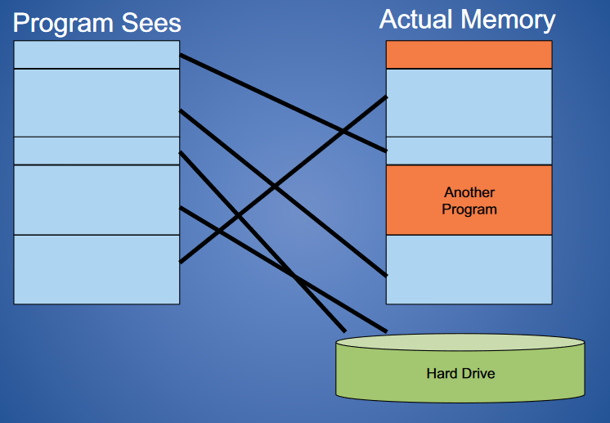
Virtual memory
Mapping virtual Address to real address

Slide 69
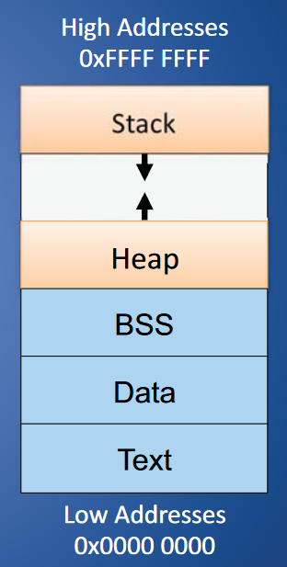
Unix Address Space
Text: machine code of the program, compiled from the source code
Data: static program variables initialized in the source code prior to execution
BSS (block started by symbol): static variables that are uninitialized
Heap : data dynamically generated during the execution of a process
Stack: structure that grows downwards and keeps track of the activated method calls, their arguments and local variables

Slide 70
Stack Frame
high
arguments
return address
stack frame pointer
exception handlers
local variables
Stack
Growth
callee saved registers
SP
low

Slide 71
Buffer Overflow Attack in a Nutshell
The attacker exploits an unchecked buffer to perform a buffer overflow attack
The ultimate goal for the attacker is getting a shell that allows to execute arbitrary commands with high privileges
Kinds of buffer overflow attacks:
Stack smashing
Heap spraying

Slide 72
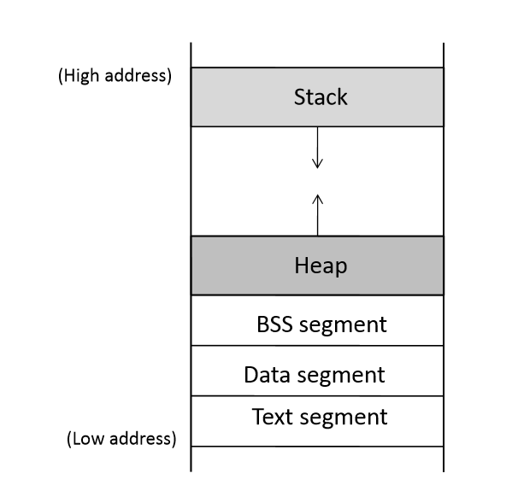
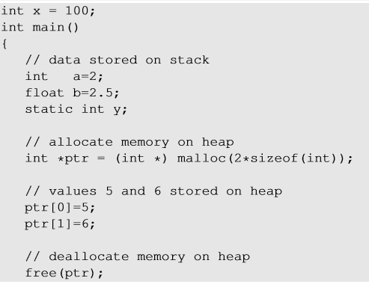

Program Memory Stack
a,b, ptr
ptr points to the memory here
y
x
Notes:
Global variables are stored in Data segment.
Uninitialized static variables are stored in BSS.
Dynamic memory is allocated in heap.
Local variables are stored in Stack.

Slide 73
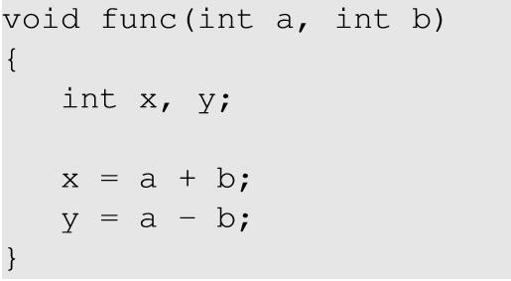
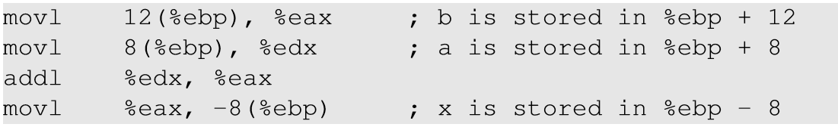
Order of the function arguments in stack
Notes:
The local variables and function arguments are stored in the stack with reference to ebp. The argument ‘b’ is stored at a higher address and hence is pushed into the stack before. The function arguments are pushed into the stack in reverse order.

Slide 74
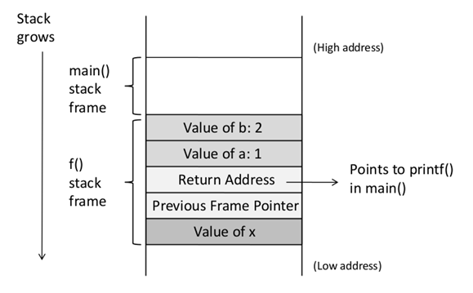
Function Call Stack
void f(int a, int b)
{
int x;
}
void main()
{
f(1,2);
printf("hello world");
}
Notes:
Main function calls f() with arguments a and b. f function stack frame is created below the main function stack. The returns address in the f() stack frame points to the next instruction address after the function is executed and returned. Here, it points to the printf() instruction.

Slide 75
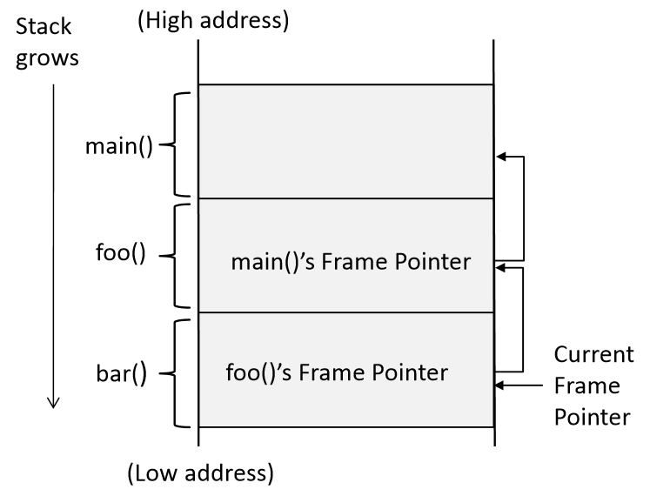
Stack Layout for Function Call Chain
main()
foo()
bar()
Notes:
The figure shows how functions are pushed into the stack. The return address in every function stack points to the next instruction that will be executed after the return. The frame pointer (ebp) of the caller function is stored in the callee’s function stack, so when the callee returns, the ebp register can point to the caller’s function stack.

Slide 76
What are buffer overflows?
Suppose a web server contains a function:
void func(char *str) { char buf[128];
strcpy(buf, str); do-something(buf); }
When func() is called stack looks like:
argument: str
return address
stack frame pointer
char buf[128]
SP

Slide 77
What are buffer overflows?
What if *str is 136 bytes long?
After strcpy:
void func(char *str) { char buf[128];
strcpy(buf, str); do-something(buf); }
argument: str
return address
stack frame pointer
Poisoned return address!
Problem: no bounds checking in strcpy()
*str
char buf[128]
SP

Slide 78
Consequences of Buffer Overflow
Overwriting return address with some random address can point to :
Non-existing address
Access violation
Invalid instruction
Attacker’s code Malicious code to gain access

Slide 79
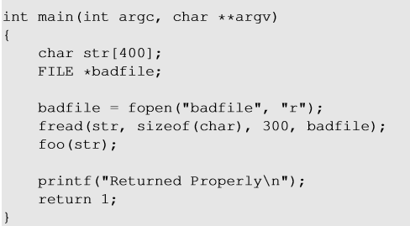
Vulnerable Program
Reading 300 bytes of data from badfile.
Storing the file contents into a str variable of size 400 bytes.
Calling foo function with str as an argument.
Note : Badfile is created by the user and hence the contents are in control of the user.

Slide 80
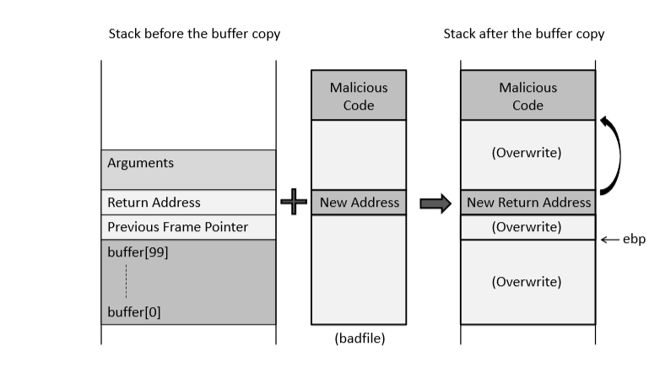
How to Run Malicious Code
Notes:
To run malicious code, we need to find a place in the function stack which will point to our code, jump to it and execute it. As we had seen that, when a function is executed it jumps to the return address (the instruction after the function was called in the caller function) , we can modify the return address with the address of the malicious code so that it jumps to the code and executes it.

Slide 81
Basic stack exploit
Program P
high
Suppose *str is such that after strcpy stack looks like:
Program P: exec(“/bin/sh”)
When func() exits, the user gets shell !
Note: attack code P runs in stack.
(exact shell code by root)
return address
char buf[128]
low

Slide 82
Some Issues
How do we know what value the pointer should have (the new “return address”).
It’s the address of the buffer, but how do we know what address this is?
How do we build the “small program” and put it in a string?

Slide 83
Resolving the issues
Guessing Address
Small Program
Typically you need the source code so you can estimate the address of both the buffer and the return-address.
An estimate is often good enough! (more on this in a bit).
Typically, the small program stuffed in to the buffer does an exec().
Sometimes it changes the password db or other files…

Slide 84
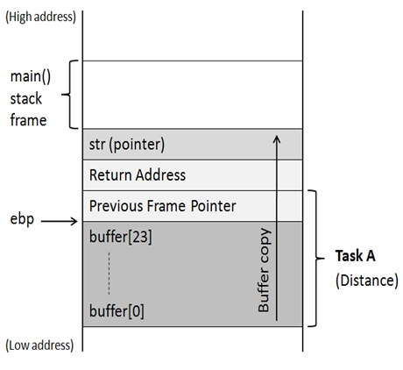
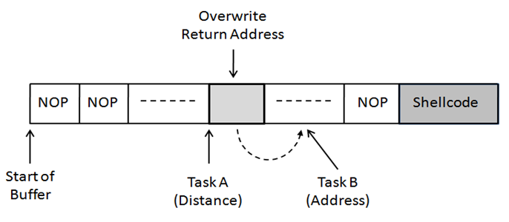
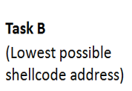
Creation of The Malicious Input (badfile)
Task A : Find the offset distance between the base of the buffer and return address.
Task B : Find the address to place the shellcode
Notes:
The two challenges faced when running the malicious code are :
Find the offset distance between the base of the buffer and return address so that we can modify the return with address of the code.
Find the address of the malicious code. If we don’t handle this, our malicious code will be stored in some random memory location to which we have control to. In that case we cannot modify the return address with the address of our code. Hence, we will put our malicious code in the function stack itself.
So,we need do the following on our badfile :
Write the malicious code (shellcode : discussed in later slides)
Place the malicious code in our stack ( At the lowest address above return address or at the end of the of the buffer)
Modify return address with address of the shell code

Slide 85
Task A : Distance Between Buffer Base Address and Return Address
Using GDB
1.Set breakpoint
(gdb) b bof
(gdb) run
2.Print buffer address
(gdb) p &buffer
3.Print frame pointer address
(gdb) p $ebp
4.Calculate distance
(gdb) p 0x02 – 0x01
5.Exit (quit)
Breakpoint at vulnerable function using gdb
Find the base address of buffer
Find the address of the current frame pointer (ebp)
Return address is $ebp +4
Notes:
To find the distance between the base of the buffer and the return address, we need to use a gdb debugging tool. given that we have access to the vulnerable code, we can use gdb to the base address of the buffer, address of the frame pointer (ebp) and return address ($ebp + 4)

Slide 86
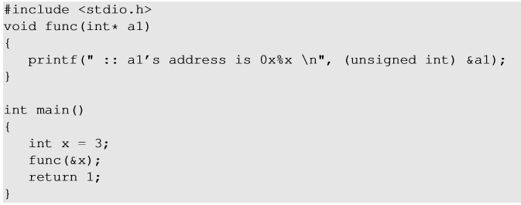
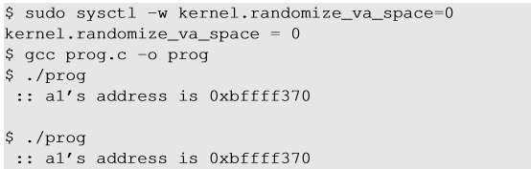
Task B : Address of Malicious Code
Investigation using gdb
Malicious code is written in the badfile which is passed as an argument to the vulnerable function.
Using gdb, we can find the address of the function argument.

Slide 87
exec() example
#include <stdio.h>
char *args[] = {"/bin/ls", NULL};
void execls(void) {
execv("/bin/ls",args);
printf(“I’m not printed\n");
}

Slide 88
ShellCode Injection
An exploit takes control of attacked computer so injects code to "spawn a shell" or "shellcode"
A shellcode is:
Code assembled in the CPU's native instruction set (e.g. x86 , x86-64, arm, sparc, risc, etc.)
Injected as a part of the buffer that is overflowed.
We inject the code directly into the buffer that we send for the attack
A buffer containing shellcode is a "payload"

Slide 89
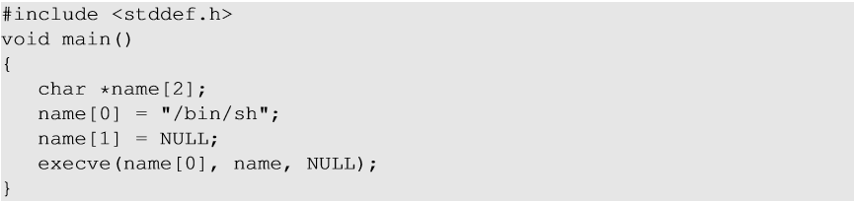
Shellcode
Aim of the malicious code : Allow to run more commands (i.e) to gain access of the system.
Solution : Shell Program
Challenges :
Loader Issue
Zeros in the code
Notes:
The above C code gives the shell prompt to execute more commands. We can compile the above C code into binary and store it into the badfile with modified return address field to the address of main(). But there are issues with this solution :
Loader Issue : OS loader is responsible for setting up the memory, copying the program to the memory and invoking dynamic linker to link libraries etc to set up the running environment of the program.After the initializations steps are completed, main() is called. If any of the steps are missing, program won’t be loaded to the memory. In buffer flow program, we are copying the code using memory copy. Therefore all the initialization steps are missing and hence, our shell code won’t be executed.
Zeros in the code : strcpy() stops copying when a zero is found in the source string. When the C code is compiled ot binary, there will be zeros in the binary code which will stop copying the badfile further.

Slide 90
Shelllcode
Assembly code (machine instructions) for launching a shell.
Goal: Use execve(“/bin/sh”, argv, 0) to run shell
Registers used:
eax = 0x0000000b (11) : Value of system call execve()
ebx = address to “/bin/sh”
ecx = address of the argument array.
argv[0] = the address of “/bin/sh”
argv[1] = 0 (i.e., no more arguments)
edx = zero (no environment variables are passed).
int 0x80: invoke execve()

Slide 91
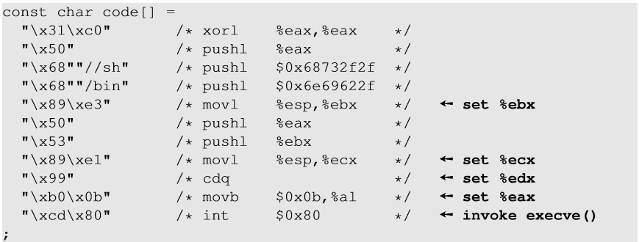
Shellcode
%eax = 0 (avoid 0 in code)
set end of string “/bin/sh”

Slide 92
Generating a String
You can take code like the previous slide, and generate machine language.
Copy down the individual byte values and build a string.
To do a simple exec requires less than 100 bytes.
Does an exec() of /bin/ls:
unsigned char cde[] =
"\xeb\x1f\x5e\x89\x76\x08\x31\xc0”
“\x88\x46\x07\x89\x46\x0c\xb0\x0b"
"\x89\xf3\x8d\x4e\x08\x8d\x56\x0c”
“\xcd\x80\x31\xdb\x89\xd8\x40\xcd"
"\x80\xe8\xdc\xff\xff\xff/bin/ls";

Slide 93
Some important issues
The small program should be position-independent – able to run at any memory location.
It can’t be too large, or we can’t fit the program and the new return-address on the stack!

Slide 94
Unix Shell Command Substituion
The Unix shell enables a command argument to be obtained from the standard output of another
This feature is called command substitution
When parsing command line, the shell replaces the output of a command between back quotes with the output of the command
Example:
File name.txt contains string
The following two commands are equivalent
finger 'cat name.txt’
finger farasi

Slide 95
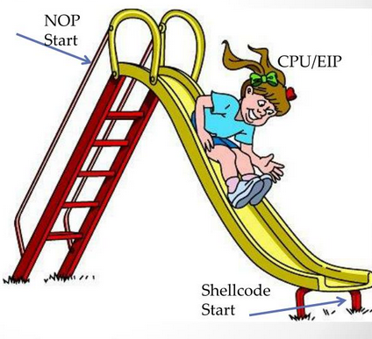
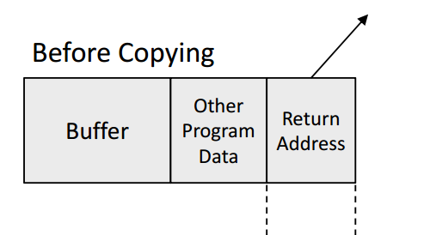
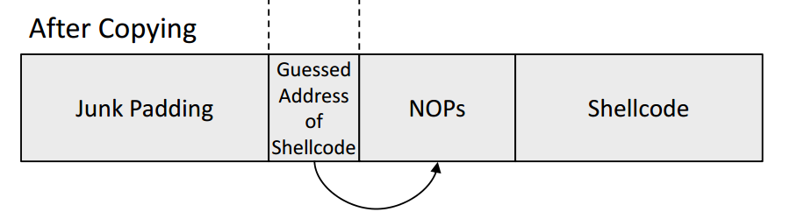
The NOP slide
Problem: how does attacker determine ret-address?
Solution: NOP slide
A NOP or No-op is a CPU instruction that does not actually do anything except tell the processor to proceed to the next instruction.
nop , xor eax,eax , inc ax

Slide 96
The NOP slide
Program P
high
the attacker crafts a payload that contains
an appropriate amount of data to overrun the buffer,
a guess for a reasonable return address in the process’s address space,
a very large number of NOP instructions
finally, the malicious code. P
processor will then “sled through” all of the NOPs until it finally reaches the malicious code, which will then be executed
NOP Slide
return address
char buf[128]
low

Slide 97
Details and examples
Some complications:
Program P should not contain the ‘\0’ character.
Overflow should not crash program before func() exits.
(in)Famous remote stack smashing overflows:
Overflow in Windows animated cursors (ANI). LoadAniIcon()
Buffer overflow in Symantec virus detection (May 2016)
overflow when parsing PE headers … kernel vuln.
Notes:
Animated cursor on web page or email message would result in arbitrary code execution. Used for rendering cursors, animated cursors, and icons.
Symantec: https://bugs.chromium.org/p/project-zero/issues/detail?id=820

Slide 98
Buffer Ovreflow Mitigation
We know how a buffer overflow happens, but why does it happen?
This problem could not occur in Java; it is a C problem
In Java, objects are allocated dynamically on the heap (except ints, etc.)
Also cannot do pointer arithmetic in Java
In C, however, you can declare things directly on the stack
Notes:
One solution is to make the buffer dynamically allocated
Another solution is using safe functions while copying strings in buffer
An alternative is to install a kernel patch that dynamically substitutes calls to unsafe library functions for safe versions of those
Use canary guard

Slide 99
Countermeasures
Developer approaches:
Use of safer library functions
Static Code analyzer
OS approaches:
ASLR (Address Space Layout Randomization)
Compiler approaches:
Canary-Guard (Stackguard)
Hardware approaches:
Non-Executable Stack

Slide 100
Use safer library function
Some unsafe C string functions.
strcpy (char *dest, const char *src)
strcat (char *dest, const char *src)
gets (char *s)
scanf ( const char *format, … ) and many more.
Use of safer functions like strncpy(dest, src, n), strncat() etc. dest[n] = ‘\0’
safer dynamic link libraries that check the length of the data before copying.
install a kernel patch that dynamically substitutes calls to unsafe library functions for safe versions of those

Slide 101
Static code analyzer
Use a code analyzer to detect buffer overflows
Since checking that arbitrary code does not overflow is an undecidable problem, the code must be annotated in order for this to work
Depends on programmer expertise (costly)
Some common and useful programming techniques are prohibited (performance and engineering costs)
Advantage is that the compiled code does not suffer from performance deterioration

Slide 102
Many unsafe libc functions
strcpy (char *dest, const char *src)
strcat (char *dest, const char *src)
gets (char *s)
scanf ( const char *format, … ) and many more.
“Safe” libc versions strncpy(), strncat() are misleading
e.g. strncpy() may leave string unterminated.
Windows C run time (CRT):
strcpy_s (*dest, DestSize, *src): ensures proper termination

Slide 103
Buffer Overflow Mitigation
Static Code Analyzer
Use a code analyzer to detect buffer overflows
Since checking that arbitrary code does not overflow is an undecidable problem, the code must be annotated in order for this to work
Depends on programmer expertise (costly)
Some common and useful programming techniques are prohibited (performance and engineering costs)
Advantage is that the compiled code does not suffer from performance deterioration
Patch at the kernel level, changing the memory mapping
Small performance penalty, by extra memory lookups (actually, extra cache lookups)
Makes it very difficult to perform a useful buffer overflow
However, unlike some other strategies, does not improve robustness (liveness) properties
Memory Address Randomization

Slide 104
Principle of ASLR
To randomize the start location of the stack that is every time the code is loaded in the memory, the stack address changes.
Difficult to guess the stack address in the memory.
Difficult to guess %ebp address and address of the malicious code

Slide 105
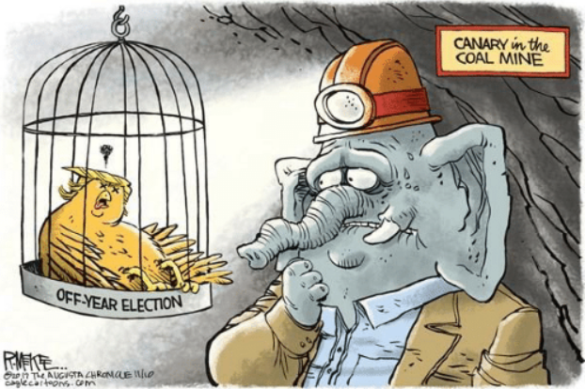


Canary Guard
Like the legendary canary-in-the-mine, it detects stack smash attacks.
Inserts a “Canary value” just below the return address (Stack Guard) or just below the previous frame pointer (Stack Smashing Protector). This value gets checked right before a function returns.
Normal Stack Configuration
Buffer Overflow Attack Attempt

Slide 106
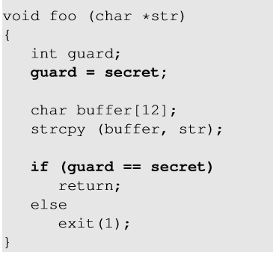
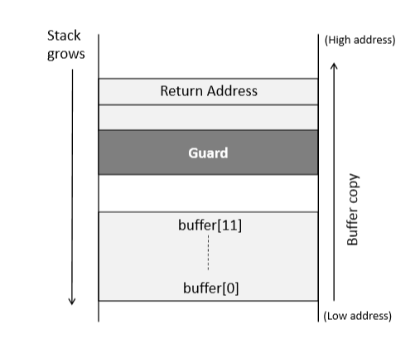
Stack guard
Notes:
Stackguard is a compiler approach to defeat buffer overflow. A random secret value is generated and stored in a memory location (not on stack) and is assigned to a local variable of the function which gets stored in the stack. After the copy function is function, it is checked if the value of the local variable is changed. If yes, buffer overflow has taken place and the program exits without returning.

Slide 107
Non-executable stack
NX bit, standing for No-eXecute feature in CPU separates code from data which marks certain areas of the memory as non-executable.
This countermeasure can be defeated using a different technique called Return-to-libc attack (see later)

Slide 108
Heap based Buffer Overflow Attack
Dynamically allocated memory is stored in a large portion of unused memory known as the heap in memory.
A program that copies user-supplied data into a block of memory allocated on the heap in an unsafe way can result in overflow conditions,
int main(int argc, char *argv[ ]) { char *buf = malloc(256); char *buf2 = malloc(16); strcpy(buf, argv[1]); printf("Argument: %s\n", buf); free(buf); free(buf2); return 1; }

Slide 109
Prevention
Address space randomization prevents the attacker from reliably guessing memory locations, making the attack more difficult.
make the heap nonexecutable, making it more difficult to place shellcode.
the single most important preventive measure is safe programming

